Slide 1
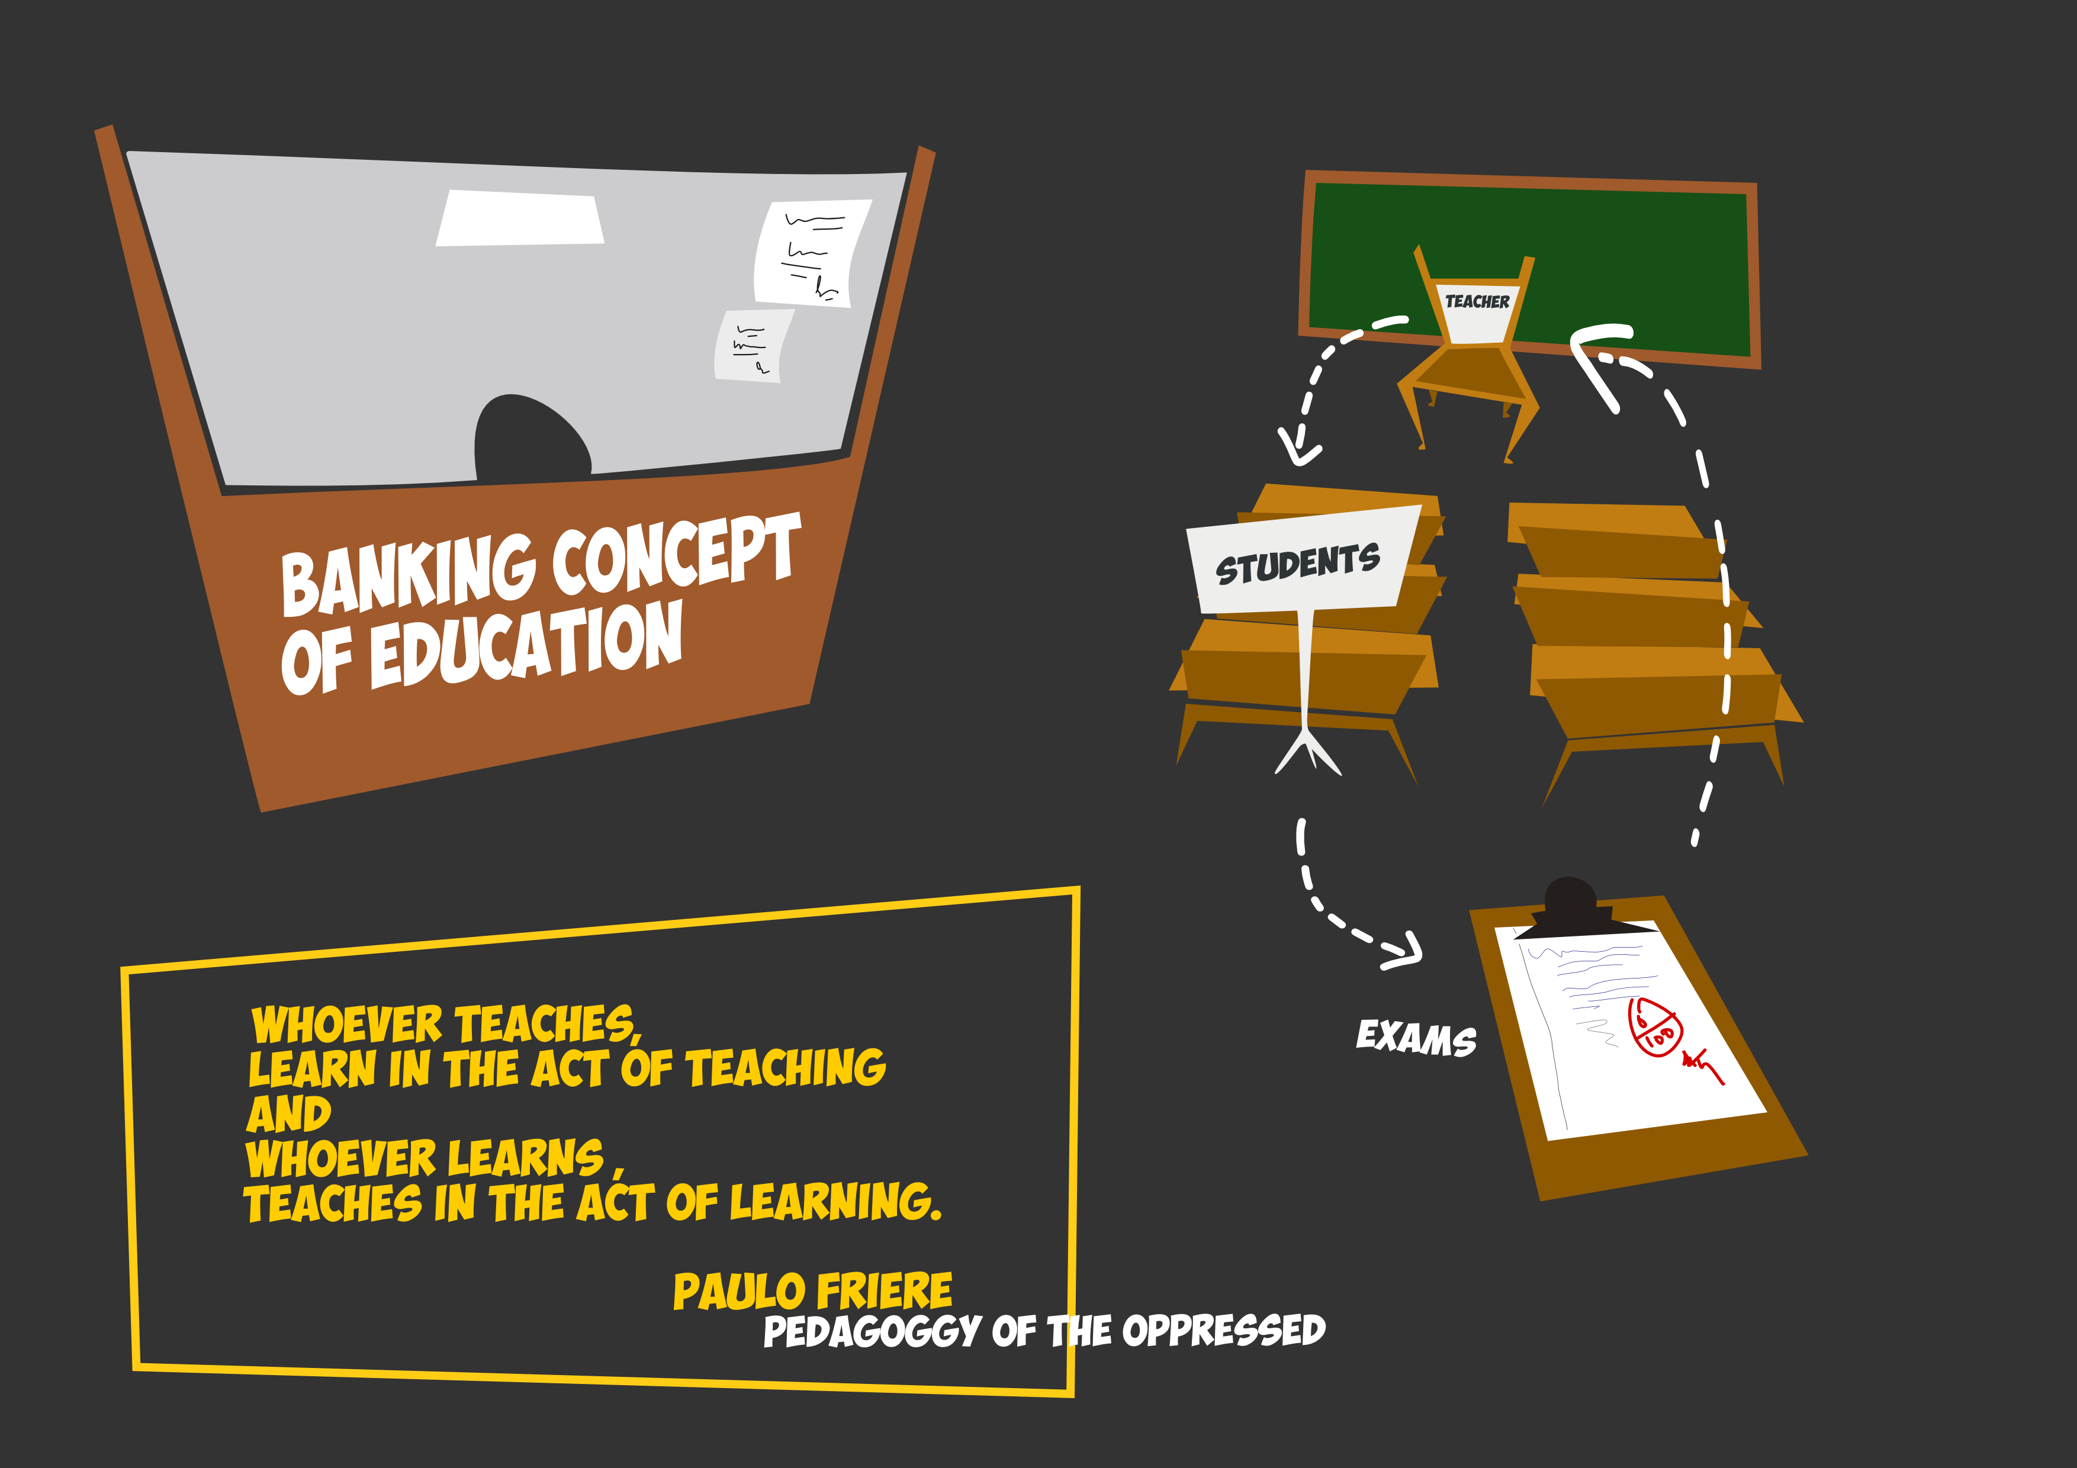
How are the sessions going to be ?

Slide 2
For whom the sessions are :
Intended ?
1.Thirst for knowledge
2.Unleashing creative potential
3.Community Building
Not so intended for
-->Only certificate
-->சொன்னனாங்கக சேர்ந்ததன்
-->ஒரு session , ஒரே session,I must be placed in a MNC

Slide 3
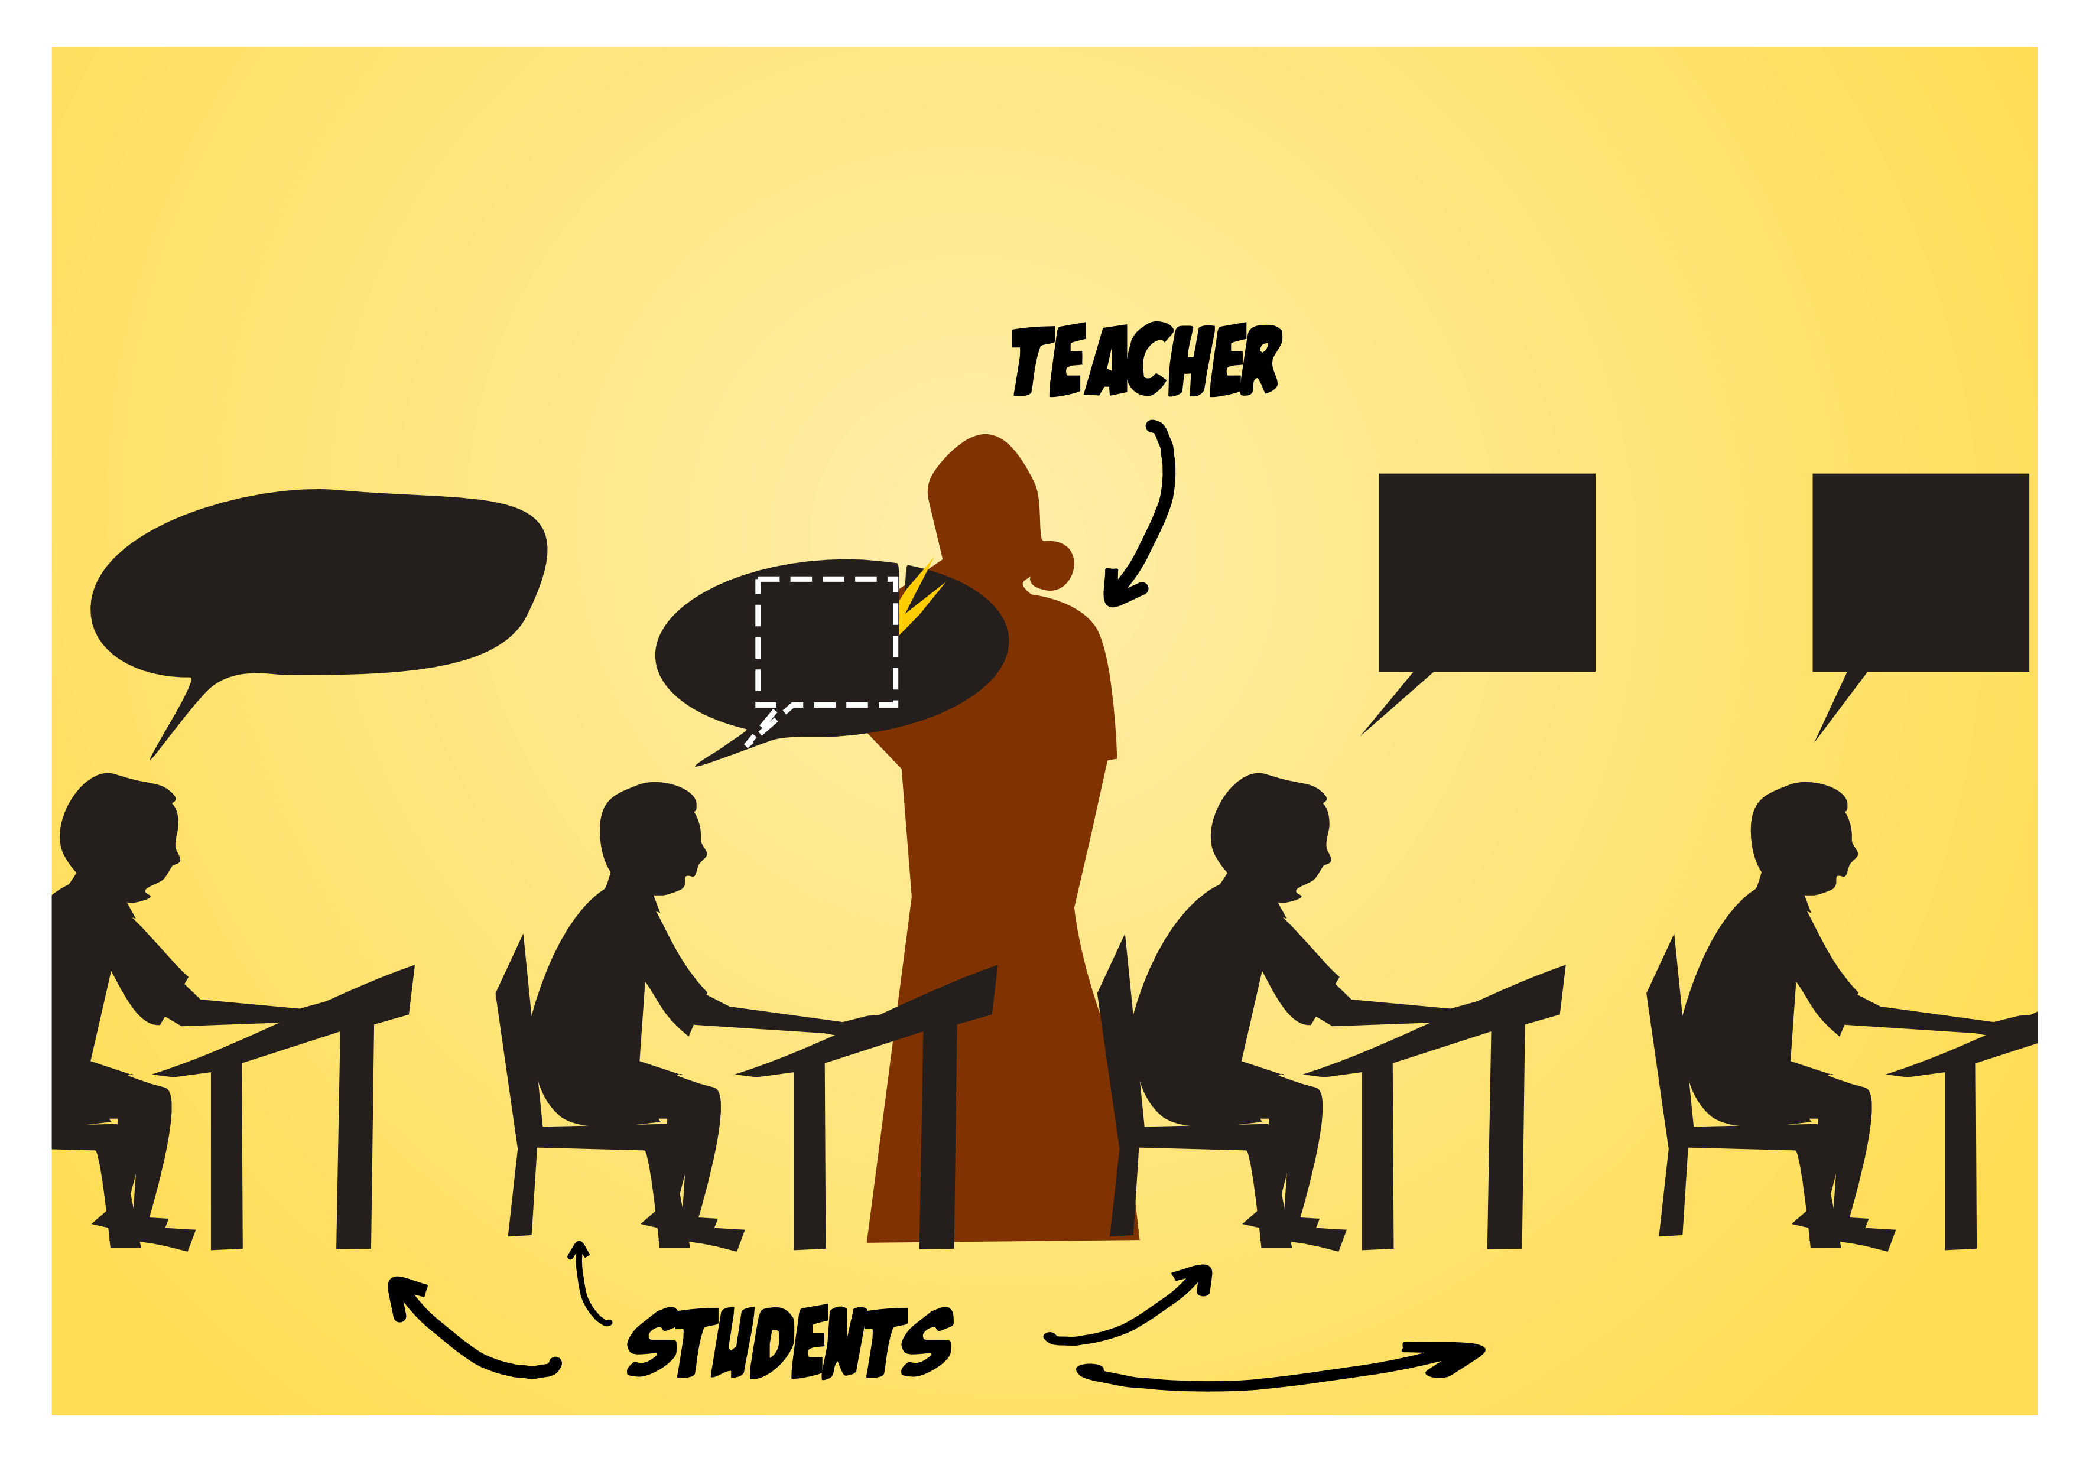
How are the sessions not going to be ?

Slide 4

What is free as in Free Coffee?

Slide 5

What is Free as in Freedom?

Slide 6

Freedom 0

Slide 7
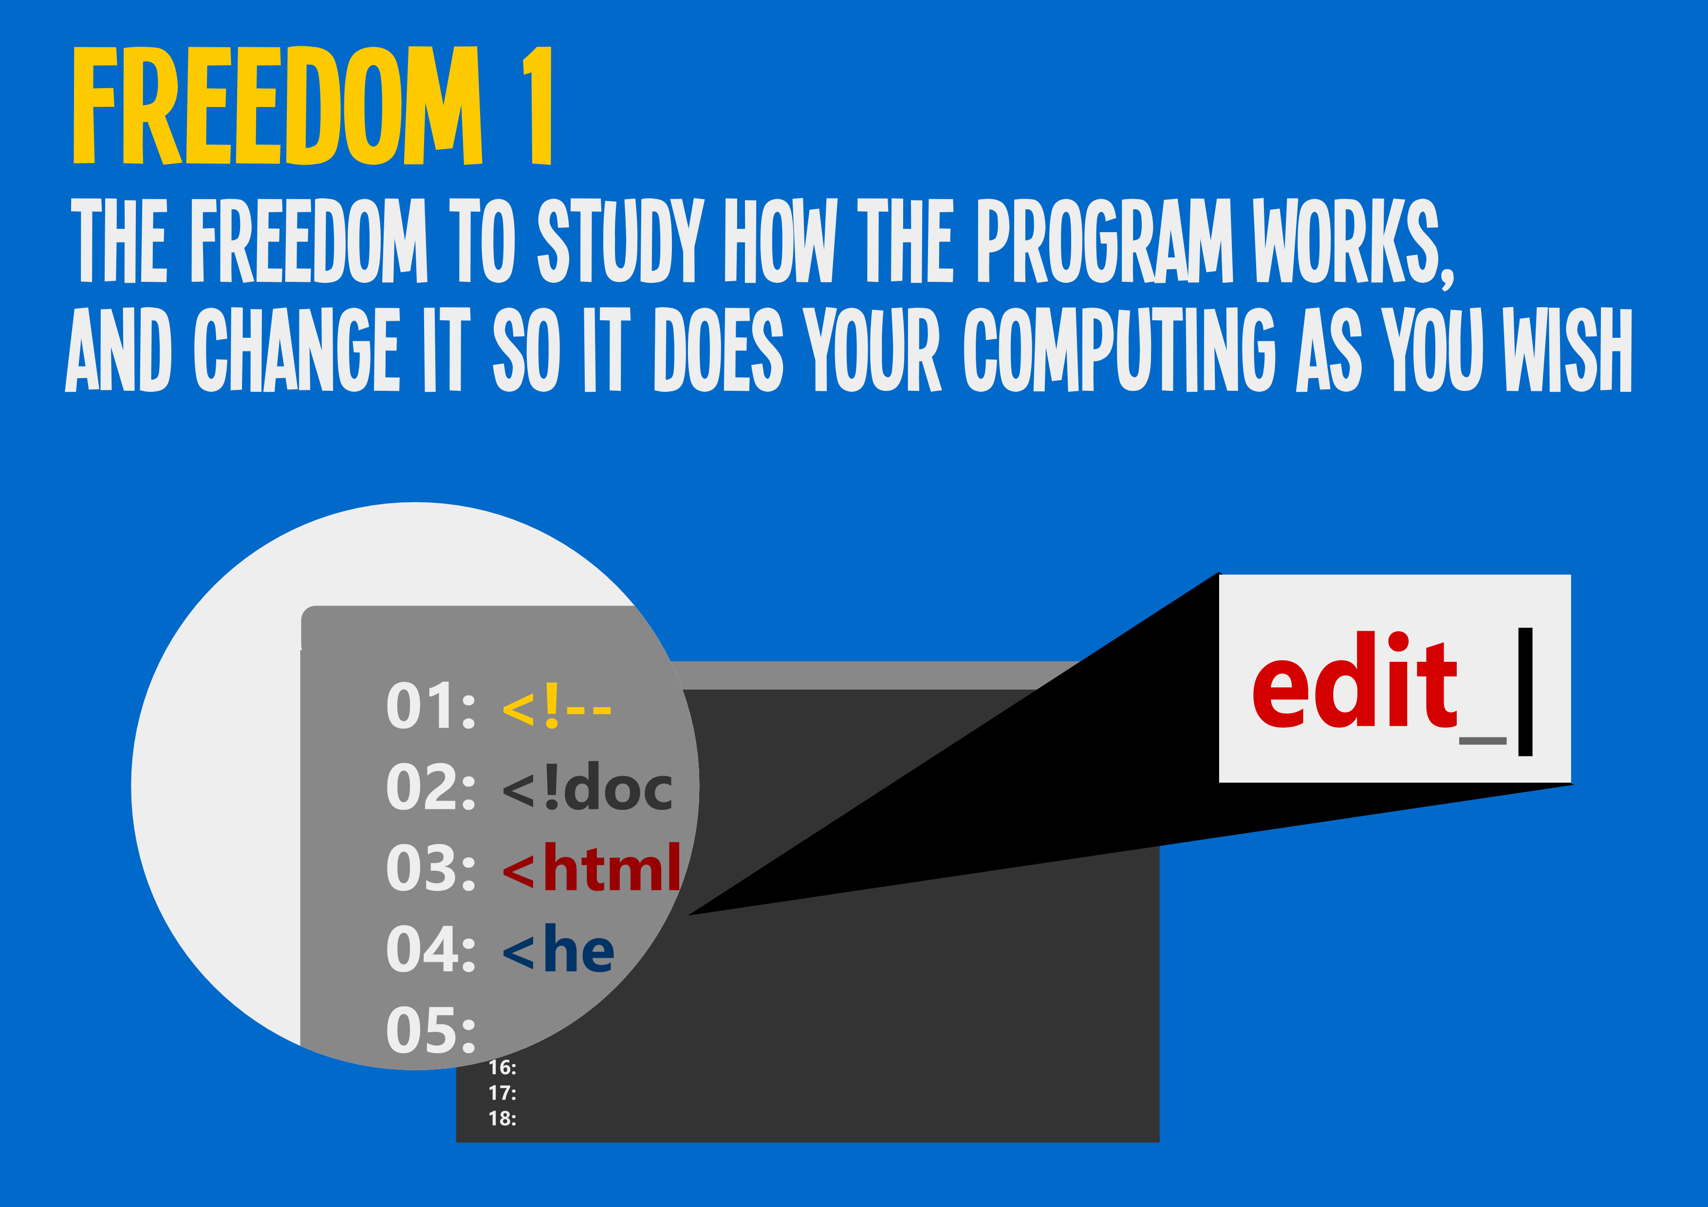
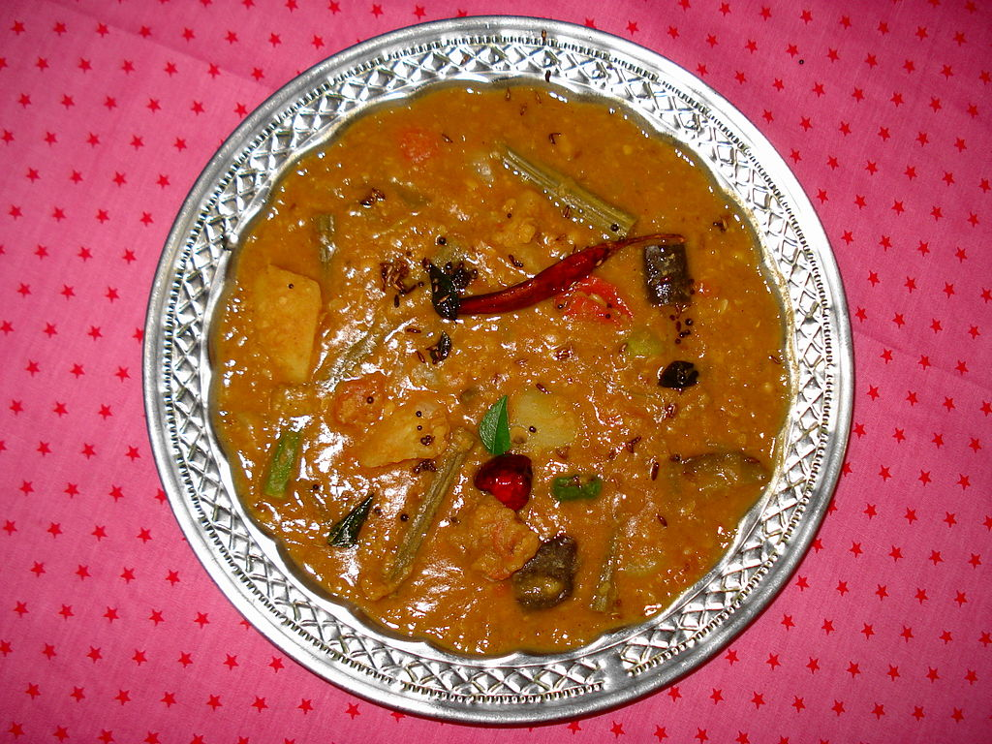
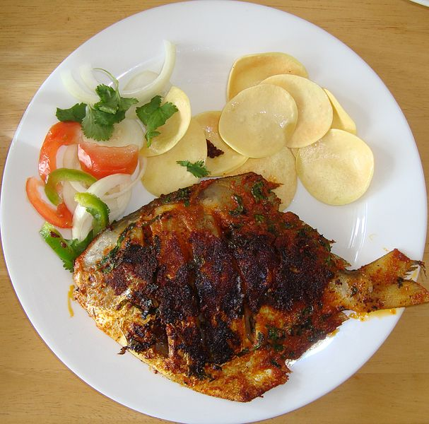
Freedom 1

Slide 8

Freedom 2

Slide 9
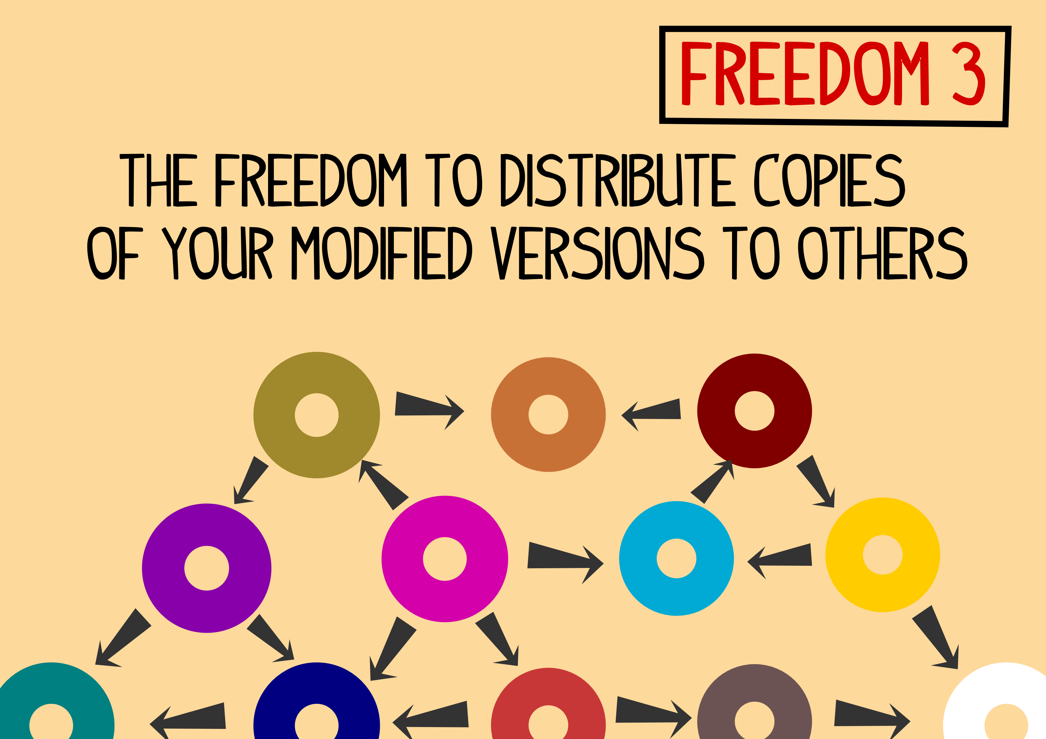
Freedom 3

Slide 10



What is GNU/Linux ?

Slide 11
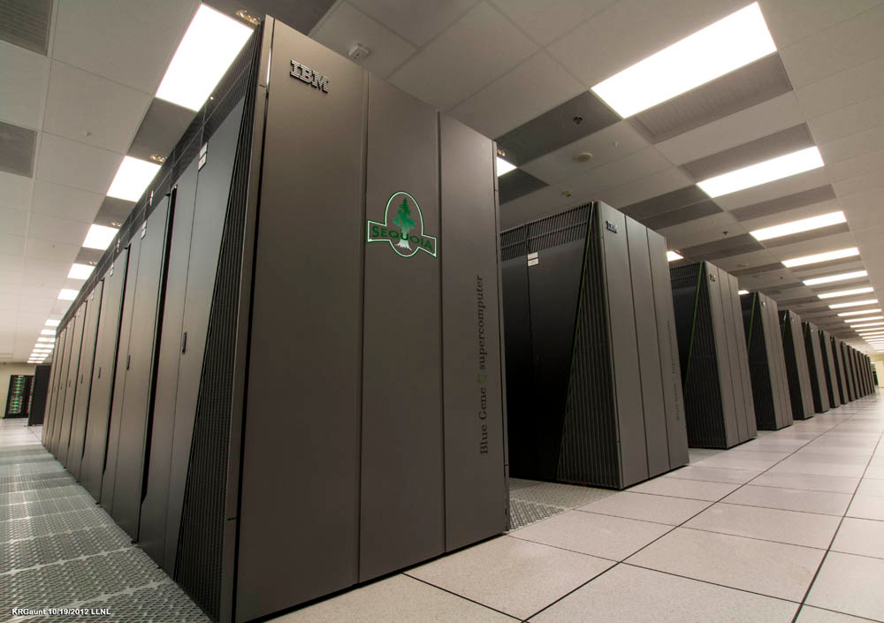
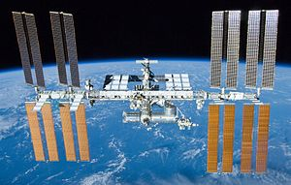
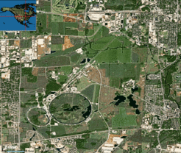
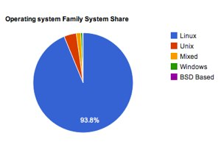
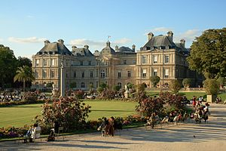


Sounds Cool .But............. Is any organisation using this “Free Software”?
FermiLab(Particle Accelerator)
IBM Sequoia
International Space Station (ISS)

Slide 12


But.......... Is anybody using this Free Software?

Slide 13










Yes , there are millions, including you

Slide 14
The current state of Engineering - Small Glimpse
“The National Employability Report 2011 says that only 10 per cent of the engineering graduates from the Tamil Nadu roped in by IT companies are employable.” - http://www.thehindu.com/news/cities/chennai/tn-graduates-at-bottom-of-it-employability-list-study/article2951560.ece
India produces around 750,000 engineers every year. Of these, almost 40 per cent who scout for a job for almost a year, while around 22 per cent take almost two years before bagging a job, according to HR firms. - http://www.business-standard.com/article/economy-policy/engineering-graduates-could-become-more-unemployable-110060200055_1.html
Almost every software engineer / Engineer passes through 4 years of
  Cut – From Book
  Copy – into mind
  Paste – in the paper and they call it a Engineering degree

Slide 15
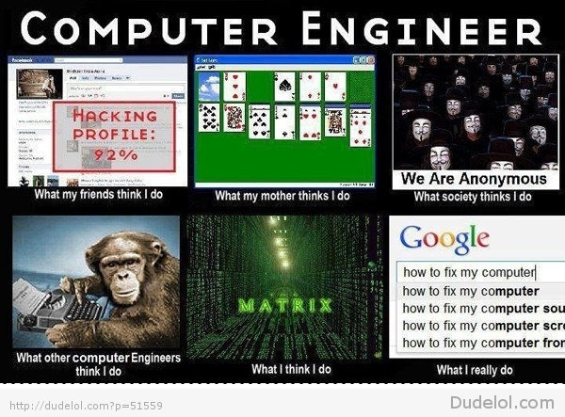
The current state of Engineering - Small Glimpse

Slide 16

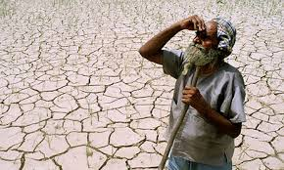
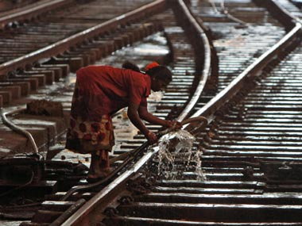
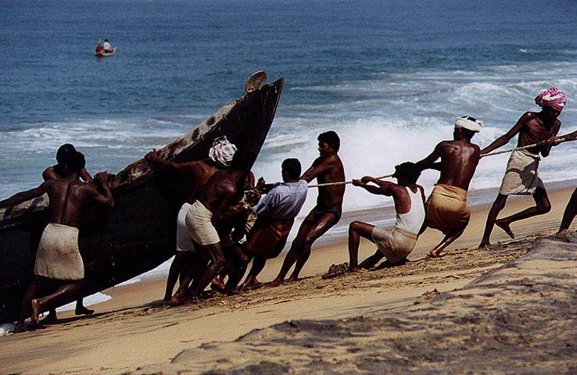

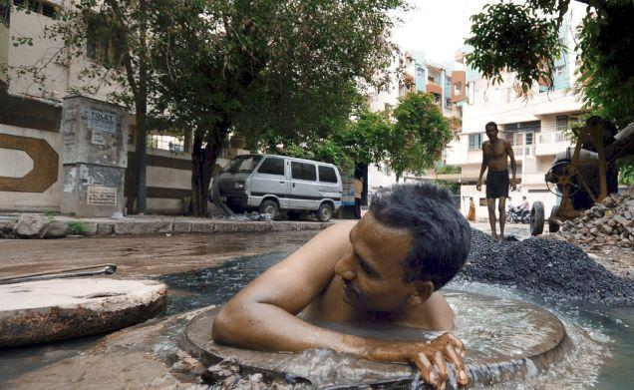
Why does a developing Country like India need Free Software?

Slide 17

Okay okay.. Now tell me where to start the Free Software Journey
Time: Today
1.Installation of GNU/Linux.
.. [ ] Example: Fedora. Get user group, mailing-list help.
2.Connect to IRC (irc.freenode.net, say, #fedora, #fedora-india).
2.1Register your IRC nick name
3.Create a blog (say, in wordpress.com, blogspot.com). Update daily status in your blog.
Credits to http://shakthimaan.com/downloads/glv/presentations/gnubie.html

Slide 18

Wait wait :) What about Free Culture ?

Slide 19
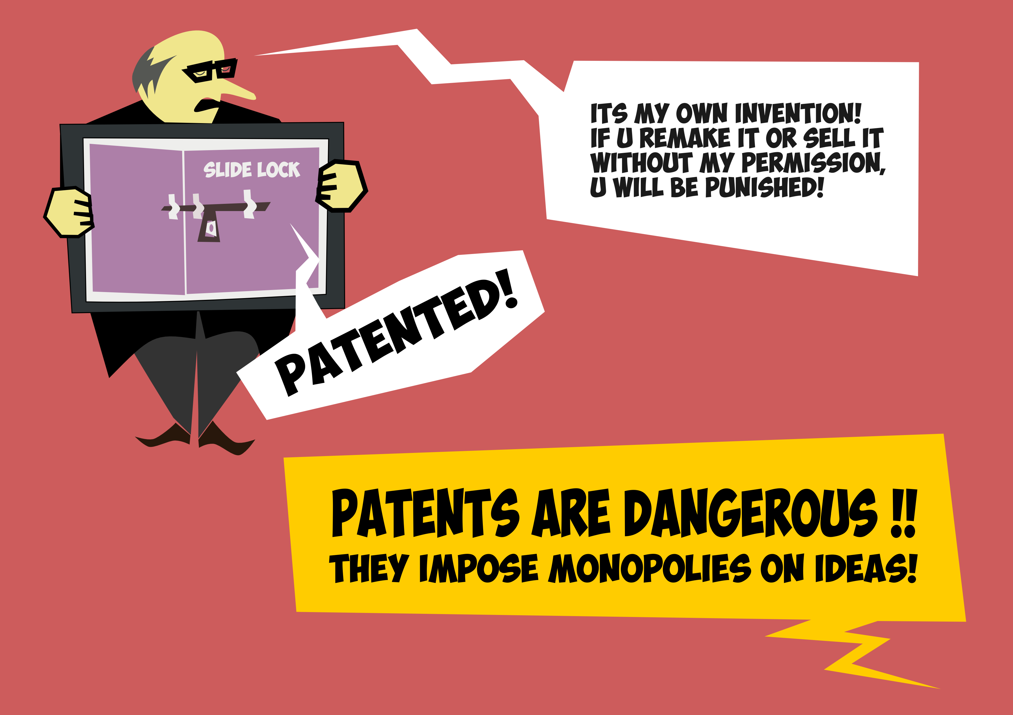
Anti – Patents

Slide 20

Wikipedia – The Free Encyclopedia

Slide 21

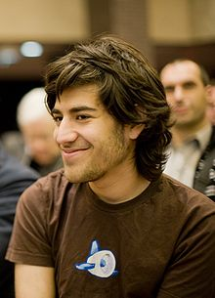
Open Access and Aaron Swartz

Slide 22


Licences – CC and GPL V3

Slide 23
Let the R(E)volution begin :)
Think out of Box
Test and keep testing
Fail as many times as possible
Enjoy Hacking

Slide 24
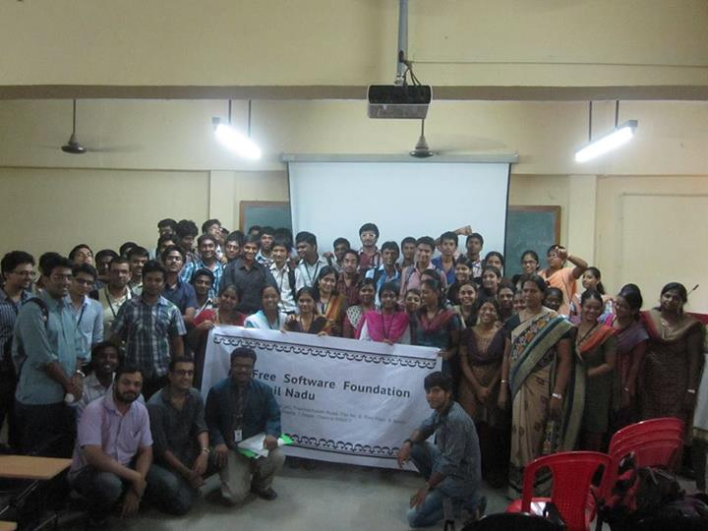
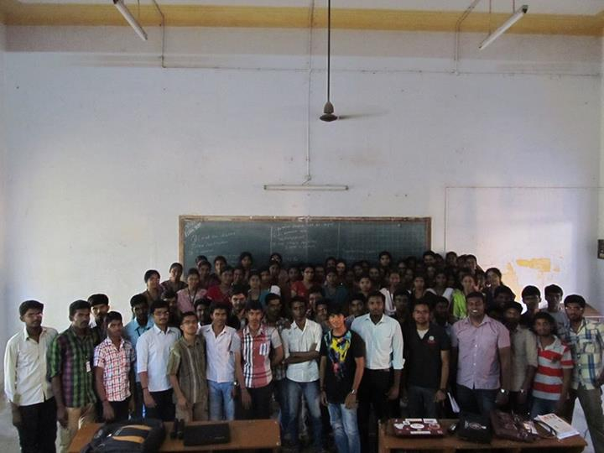
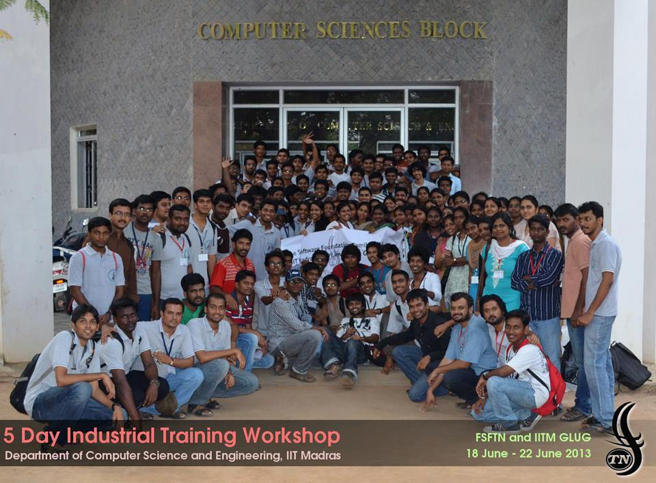
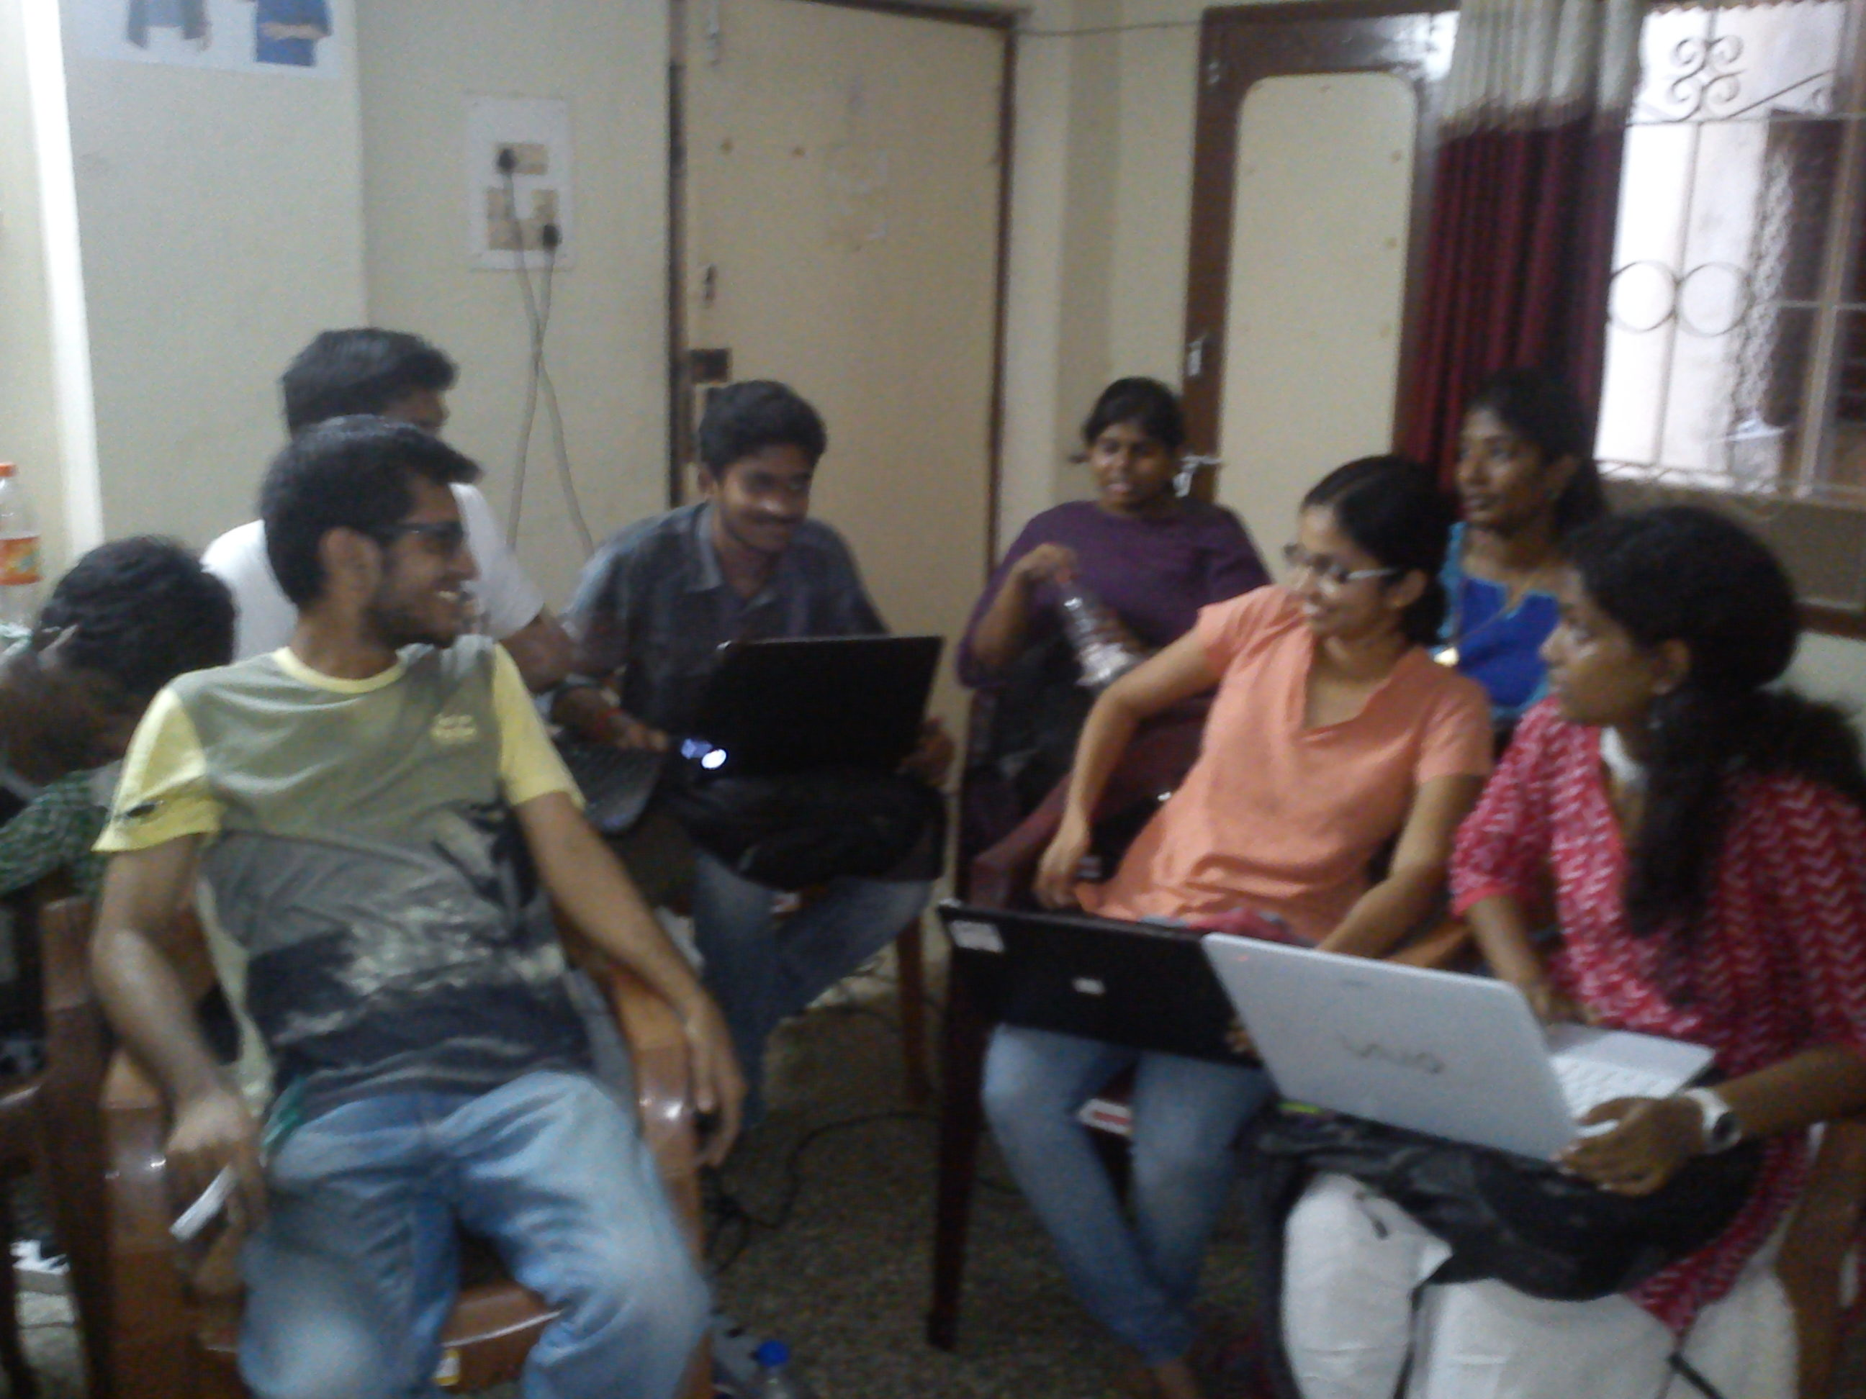



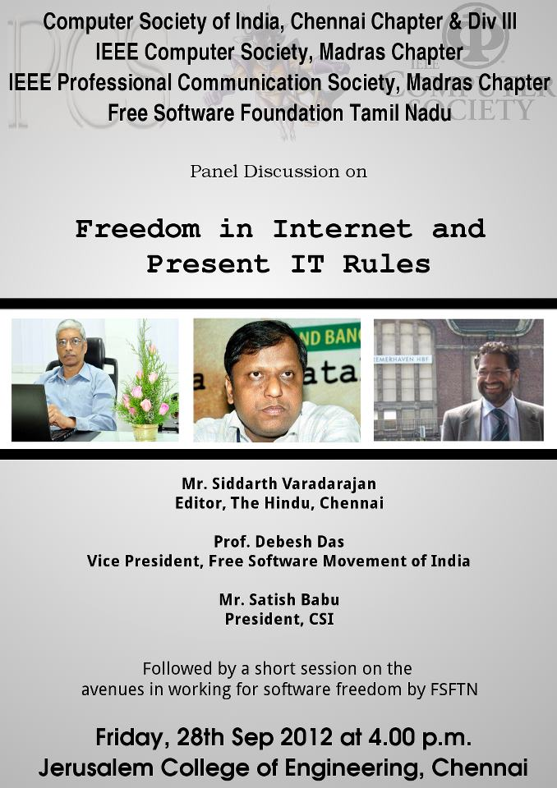
What do we do in FSFTN ?
Workshops followed by Setting
Up GLUGs in Colleges
Industrial Training workshops
Week end Free Technical sessions
Public Outreach
Gender Initiatives
Localisation
Panel Discussions

Slide 25


Slide 26
Image and Information Credits
http://en.wikipedia.org/wiki/IBM_Sequoia
http://en.wikipedia.org/wiki/International_Space_Station
http://en.wikipedia.org/wiki/French_Parliament#mediaviewer/File:Palais_Luxembourg_Sunset.JPG
http://en.wikipedia.org/wiki/Nova_%28operating_system%29#mediaviewer/File:Nova_Linux_Logo.svg

Slide 27
Copyright notices
1.All the logos shown here are copyright of the respective companies
2.http://dudelol.com/computer-engineer-what-others-think-i-do/

